Slide 1
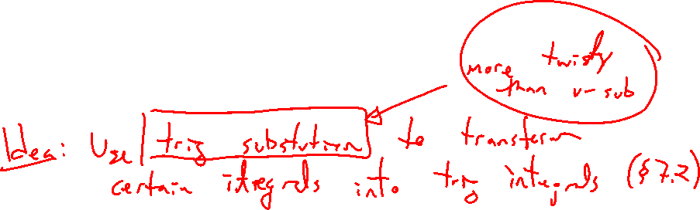
Section 7.3 Trigonometric Integrals
Lecture 1
Idea and Inverse Trigonometry

Slide 2

Section 7.3 Homework Submission to Canvas
Preview of section
Skim the section in text and write a short paragraph summary.
Give a bulleted list of all important definitions, theorems, and formulas without details.
Notes on video lectures
Take notes on everything written on slides including all details, worked examples, on-own activities, as well as your own thoughts and questions.
Try on-own activities first, then write down provided solution next to it for comparison.
Worked examples from the text
Write down the problem and attempt without looking at the solution.
Use the solution to write the best explanation you can.
Solutions to textbook exercises
Model approaches and explanations given in the video lectures and textbook examples.
Final reflection of section
List the key takeaways to remember as a bulleted list.

Slide 3
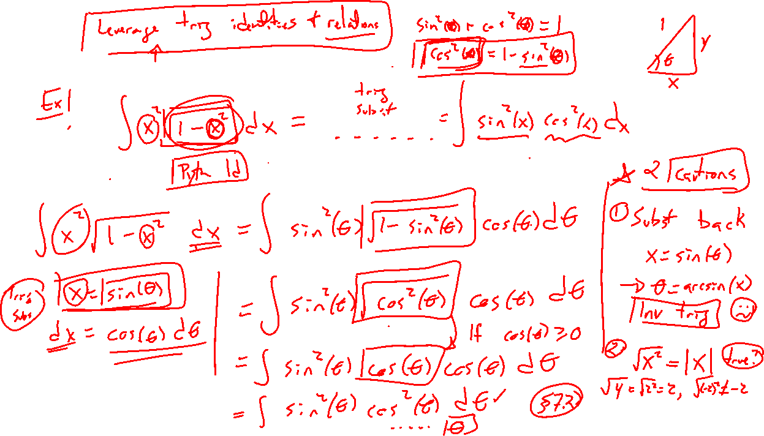
Section Motivation:
Notes:
Example: Transform \int x^2 \sqrt{1-x^2} ~dx = \int \sin^2(\theta) \cos^2(\theta) ~dtheta
How? Substitute x=\sin(theta), then dx = \cos(\theta) d\theta (remind of this weird notation, what is dx??).
Inside-out compared to u-sub.
Result is a trig integral (rather unpleasent, try something simpler first)

Slide 4
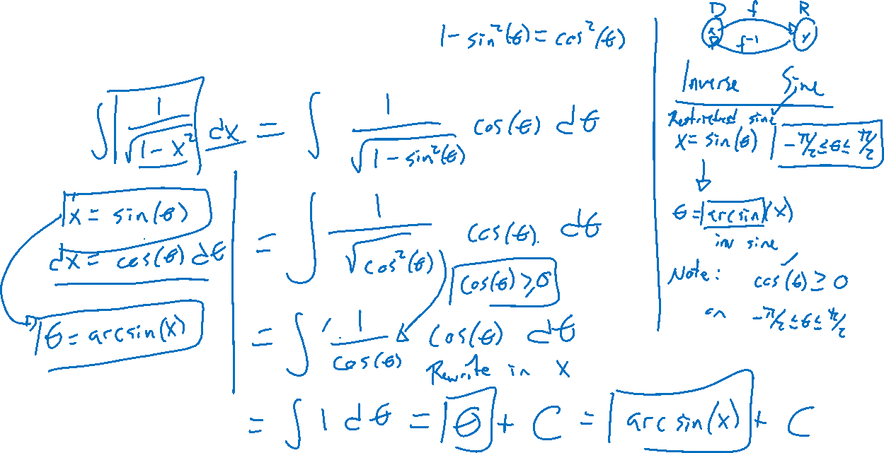
Basic Example:
Notes:
\int \frac{1}{\sqrt{1-x^2}}~dx
Again, x=\sin(\theta), dx = \cos(\theta)\dtheta
Need inverse trig (domain restriction) to substitute back.
Is \sqrt{\cos^2(\theta)} = \cos(\theta) really? \sqrt{x^2} = |x|
Domain restriction ensures \cos(\theta)>0

Slide 5
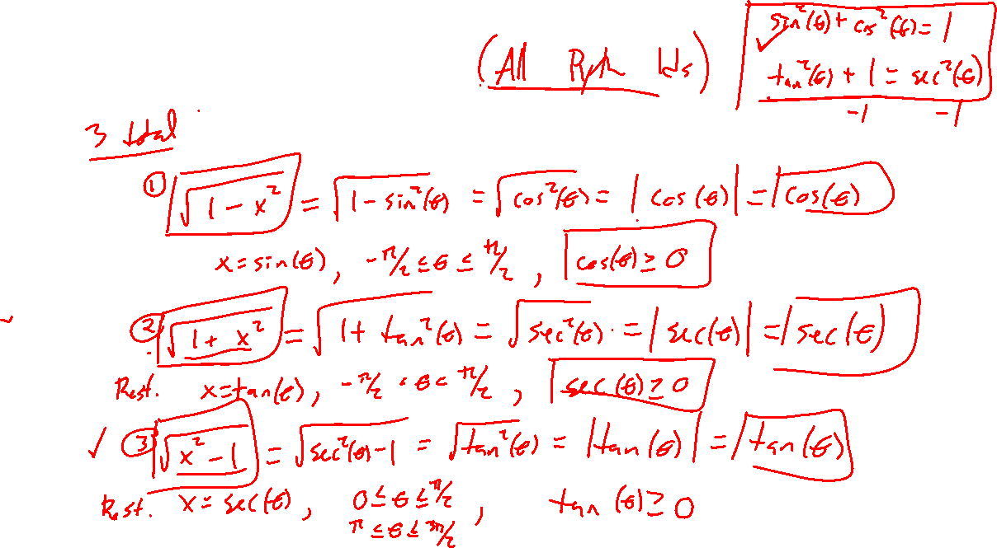
Trig Substitution Cases
Notes:
\sqrt{1-x^2}, x=\sin(\theta), list domain res
\sqrt{1+x^2}, x=\tan(\theta), list domain res
\sqrt{x^2-1}, x=\sec(\theta), list domain res
In end, clever trick to use pythagorean identities: \sin^2(\theta)+\cos^2(\theta)=1, \tan^2(\theta)+1 = \sec^2(\theta)
Domain restrictions key to inverse / positivity. Desmos the graphs of each to see

Slide 6
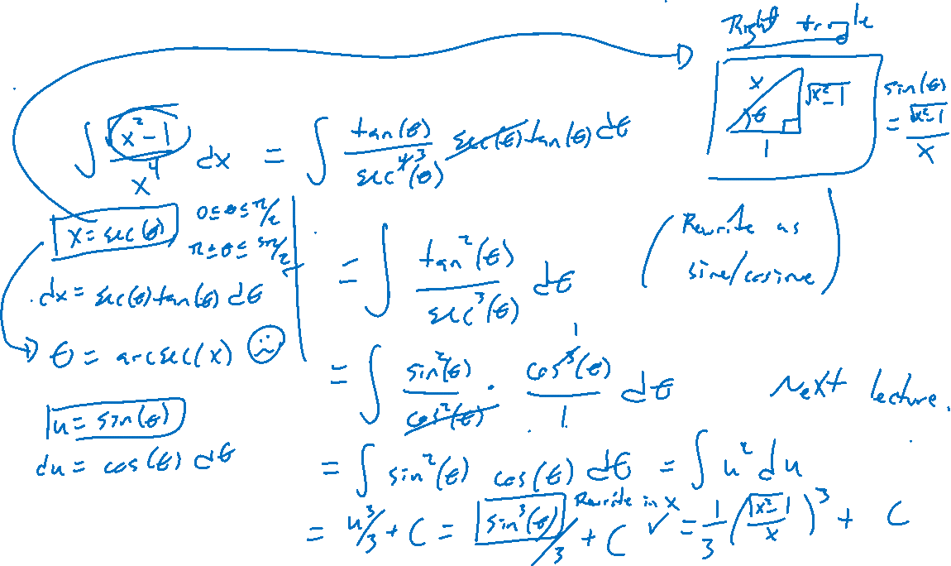
Example: Try on Own
Notes:
\int \frac{x^2-1}{x^4} ~dx

